Slide 1
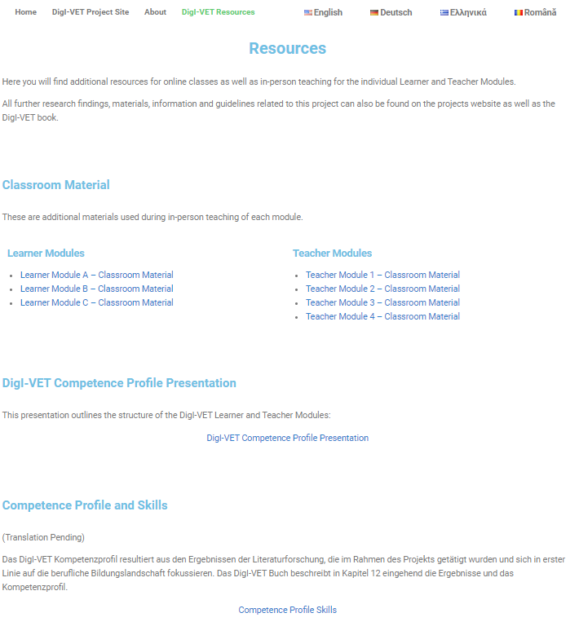
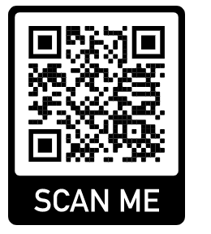
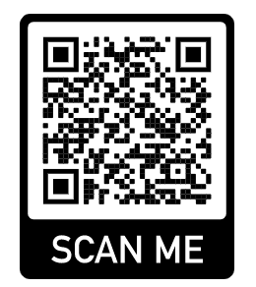
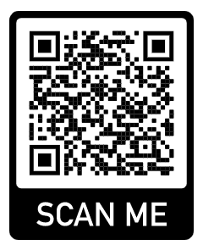
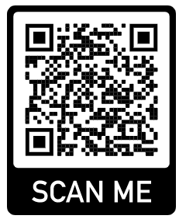
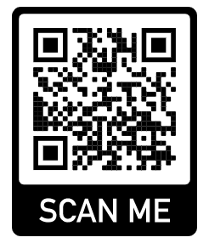
DigI-VET
DigI-VET: Fostering Digitisation and Industry 4.0 in vocational education and training Project Nummer: 2018-1-DE02-KA202-005145
DigI-VET Lerning Platform
The Erasmus + project DigI-VET "DigI-VET" Fostering Digitization and Industry 4.0 in vocational education and training - Promotion of digitization and Industry 4.0 in vocational training "promotes innovative ways of teaching and learning in the context of digitization and Industry 4.0. Besides the DigI-VET sMOOC or the DigI-VET Online Observatory, the European consortium develops an online learning platform on which learners and teachers receive extensive learning modules, teaching and learning concepts, but also links to other DigI-VET guidelines which contain face-to-face materials for the classroom as well as an extensive repertoire of interactive H5P exercises for self-study phases.
The DigI-VET learning platform is available in the project languages ​​- German, English, Romanian and Greek.
English
Learning Platform:
German
Learning Platform:
Greek
Learning Platform:
Rumanian
Learning Platform:
Link: https://digivet-tasks.eduproject.eu/digi-vet-resources/
DigI-VET Classroom Materials
In addition to the DigI-VET online learning platform, which is available in all project languages, interested learners and teachers as well as vocational trainers have access to 16 learner modules and 6 teacher modules - each in the partner languages mentioned. This results in a variety of over 80 modules!
In addition, the consortium offers a wide variety of learner-centered classroom materials and worksheets for face-to-face teaching and training. All modules and classroom materials as well as additional documents for the DigI-VET competence profile and presentations are available on the learning platform, too.
DigI-VET Homepage
All further information and downloads on the project website
Infos: http://eduproject.eu/digi-vet,
Grant Agreement No. 2018-1-DE02-KA202-005145
Lehrstuhl Wirtschaftspädagogik II
Prof. Dr. Marc Beutner
••••••
••••••

