Slide 1
DigI-VET
Project Number: 2018-1-DE02-KA202-005145
DigI-VET
FOSTERING DIGITISATION AND INDUSTRY 4.0 IN VOCATIONAL EDUCATION AND TRAINING
IO4 Teacher Module 1 –
The DigI VET Project and the DigI VET Curriculum
The European Commission support for the production of this publication does not constitute an endorsement of the contents which reflects the views only of the authors, and the Commission
cannot be held responsible for any use which may be made of the information contained therein.

Slide 2
AGENDA
The DiGI-VET Project
1.1 What DiGI-VET is about?
1.2 Main objectives and core aspects
1.3 Task
2. The DiGI-VET Curriculum
2.1 Teacher Modules
2.2 Trainer Modules
2.3 Learning Outcome Matrix
2.4 Task

Slide 3
THE DiGI-VET PROJECT

Slide 4
THE DiGI-VET PROJECT
Erasmus+-Project DiGI-VET:
“Fostering Digitization and Industry 4.0 in vocational education”
Financed by the European Union
Project duration from 1st of December 2018 to 30th of November 2020
Coordinator: Ingenious Knowledge GmbH, Cologne (Germany)
In total 5 project partners

Slide 5
THE DiGI-VET PROJECT
Project partners:
Coordinator
IK - Ingenious Knowledge Rasmus Pechuel
P2
AR Vocational Education and Training Ltd.,
Rajesh Pathak
P1
University Paderborn Marc Beutner
P4
Asociatia Oamenilor de Afaceri Agres
Romania Adrian Razvan
P3
Private Institute Emphasys Centre
Athos Charalambides

Slide 6
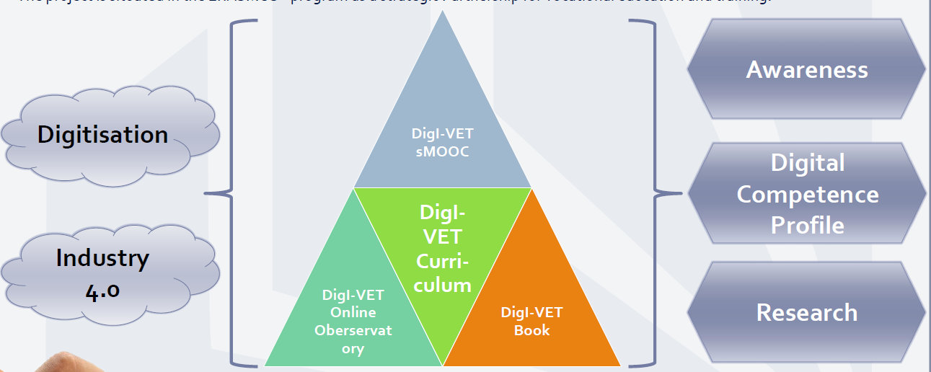
THE DiGI-VET PROJECT

Slide 7
THE DiGI-VET PROJECT
What DiGI-VET is about?

Slide 8
WHAT DiGI-VET IS ABOUT?
Megatrend DIGITSATION
Caused by global change
New requirements in any organizational context, particularly in the educational sector

Slide 9
WHAT DiGI-VET IS ABOUT?
New ways of learning → Need for adaptions
DigI-VET addresses the challenges of the rapidly changing environment in economy
DiGI-VET transfers this into pedagogical settings

Slide 10
THE DiGI-VET PROJECT
Main objectives and core aspects

Slide 11
MAIN OBJECTIVES
The aim of DigI-VET is to do qualitative and quantitative research in the partner countries to provide an online platform for VET on the DiGI-VET website and create a book with background information and didactical hints for VET teachers and trainers.

Slide 12
CORE ASPECTS
• Research on Digitisation and Industry 4.0:
The development of Digital Competence
Profiles for VET
• The design of curriculum structures for
digitization: Curriculum and materials
• Creating awareness for digitization and
industry 4.0
• Development of an innovative sMOOC
for teachers and learners in VET
• The writing and presentation of the
DigI-VET Book (provided as OER)
• Online Observatory of Digitisation
Best Practices

Slide 13
Task
TASK
Please answer the next H5P.org tasks!

Slide 14
Task
TASK
<iframe src="https://h5p.org/h5p/embed/735891" width="1090" height="392" frameborder="0" allowfullscreen="allowfullscreen"></iframe><script src="https://h5p.org/sites/all/modules/h5p/library/js/h5p-resizer.js" charset="UTF-8"></script>
Link to H5P.org: https://h5p.org/node/735891?feed_me=nps

Slide 15
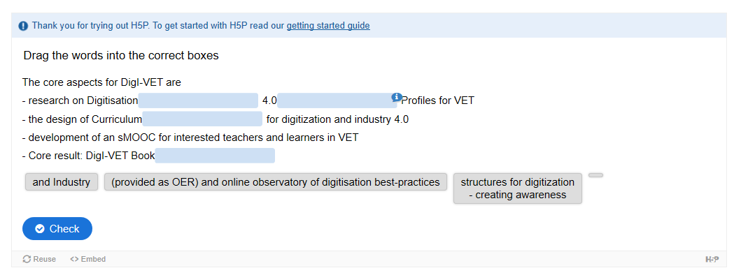
Task
TASK
<iframe src="https://h5p.org/h5p/embed/735913" width="1090" height="388" frameborder="0" allowfullscreen="allowfullscreen"></iframe><script src="https://h5p.org/sites/all/modules/h5p/library/js/h5p-resizer.js" charset="UTF-8"></script>https://h5p.org/node/735913?feed_me=nps
https://h5p.org/node/735913?feed_me=nps

Slide 16
THE DiGI-VET CURRICULUM
Teacher Modules

Slide 17
TEACHER MODULES
Module 1:
The DigI-VET project and
the DigI-VET curriculum
Module 2:
Digitisation and Industry 4.0
Terms and history
Module 3:
Good practices of
digitisation and Industry 4.0
Module 4:
The need of digitisation in today´s world of work and insights into future developments

Slide 18
THE DiGI-VET CURRICULUM
Learner Modules

Slide 19
LEARNER MODULES
Module A:
Digitisation – Terms
and history
Module B:
Industry 4.0 – Terms
and history
Module C:
Current status and
future developments

Slide 20
THE DiGI-VET CURRICULUM
Learning Outcome Matrix

Slide 21
LEARNING OUTCOME MATRIX
DigI-VET Training modules for VET-teacher and trainers
Multipliers will be trained
LOM1
These VET-teachers and trainers will provide:
2. DigI-VET modules for learners
Learners will be trained on digitisation and industry 4.0
LOM2

Slide 22
COMPETENCE PROFILE
Subject specific
Competences
Communicative
Competences
Process
related Competences
Managerial
Competences
Research related Competences
Practice related
Competences
Methodological
Competences
Social
Competences
All country results (DE, RO, GB, GR) you can find under IO1 as well as in the DigI-VET book

Slide 23
Task
TASK
Please answer the next H5P.org tasks!

Slide 24
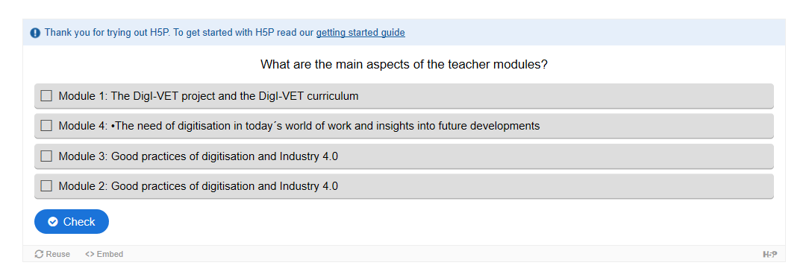
Task
Task
TASK
<iframe src="https://h5p.org/h5p/embed/735944" width="1090" height="348" frameborder="0" allowfullscreen="allowfullscreen"></iframe><script src="https://h5p.org/sites/all/modules/h5p/library/js/h5p-resizer.js" charset="UTF-8"></script>
https://h5p.org/node/735944?feed_me=nps

Slide 25
Task
TASK
<iframe src="https://h5p.org/h5p/embed/735950" width="1090" height="306" frameborder="0" allowfullscreen="allowfullscreen"></iframe><script src="https://h5p.org/sites/all/modules/h5p/library/js/h5p-resizer.js" charset="UTF-8"></script>
https://h5p.org/node/735950?feed_me=nps

Slide 26
CONTACT
Universität Paderborn
Department Wirtschaftspädagogik Lehrstuhl Wirtschaftspädagogik II Warburger Str. 100
33098 Paderborn
http://www.upb.de/wipaed
http://digivet.eduproject.eu/
Prof. Dr. Marc Beutner
Tel: +49 (0) 52 51 / 60 - 23 67
Fax: +49 (0) 52 51 / 60 - 35 63
E-Mail: marc.beutner@uni-paderborn.de
The European Commission support for the production of this publication does not constitute an
endorsement of the contents which reflects the views only of the authors, and the Commission cannot be held responsible for any use which may be made of the information contained therein.
26

