Slide 1
DigI-VET Fostering Digitization and Industry 4.0 In Vocational Education and Training
Module B Learner Module B : Industry 4.0 and history
PROJECT No: 2018-1-DE02-KA202-005145
Coordinator:
Partners:

Slide 2
What this module will cover
SECTION A
What is industry 4.0? & Task
Terms
Cyber-physical systems (CPS) & Cloud computing & Task
The internet of things (IoT) & The Industrial internet of things (IIoT) & Task
SECTION B
History of Industry 4.0 & Task
Industry 4.0 - The Fourth Industrial Revolution (video/task)
SECTION C
Agriculture 4.0 and Industry 4.0 & Task
How the use of drones will assist agriculture in Industry 4.0 & Task
Contact
References

Slide 3
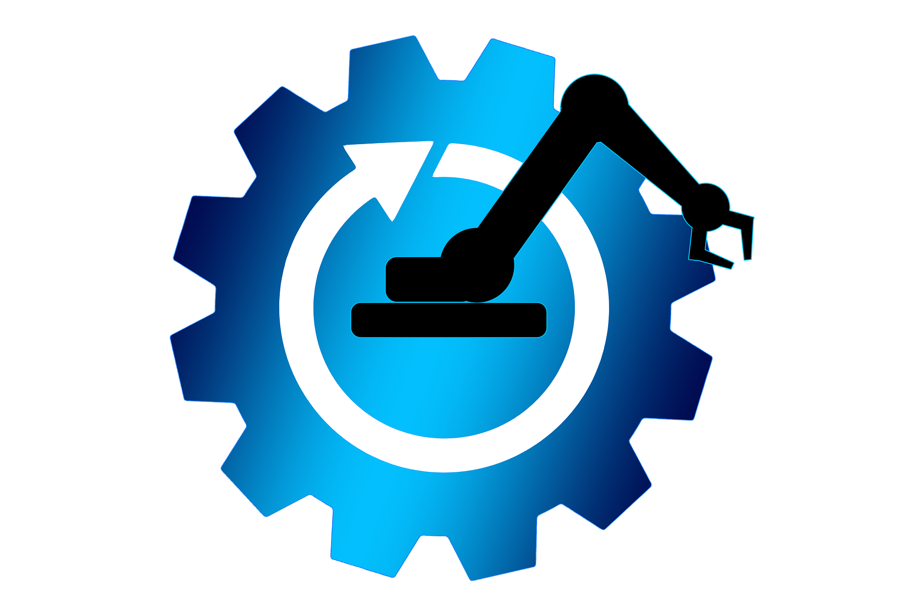
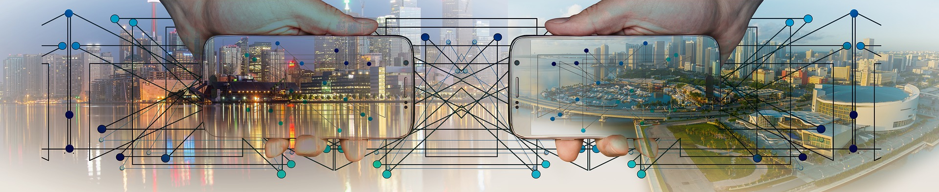
What is industry 4.0?
Industry 4.0 is essentially the Digital Networking of people, machines and products.
It is also known as the 4th industrial revolution that concerns industry.
Although the terms "industry 4.0" and "fourth industrial revolution" are often used interchangeably, “Industry 4.0" factories have machines which are intensified with wireless connectivity and sensors, connected to a system that can envision the entire production line and make decisions on its own.
Essentially, industry 4.0 is the trend towards automation and data exchange in manufacturing technologies and processes which include cyber-physical systems (CPS), the internet of things (IoT), industrial internet of things (IIOT), cloud computing, cognitive computing and artificial intelligence (AI).
Image from Pixabay https://pixabay.com/photos/city-panorama-smartphone-control-3213676/

Slide 4
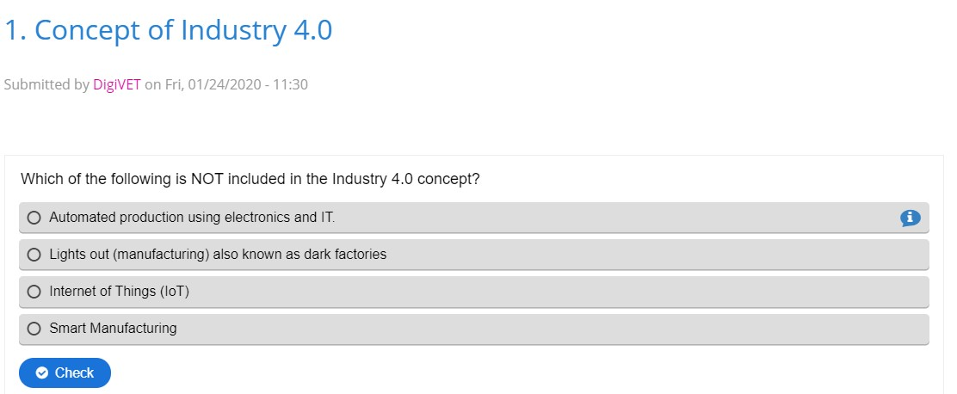
TASK
Exercise can be found in the link https://h5p.org/node/705021

Slide 5
What are all these terms?
Cloud computing
Cyber-physical systems (CPS)
The internet of things (IoT)
Artificial intelligence (AI)
Cognitive computing
Industrial internet of things (IIOT)

Slide 6
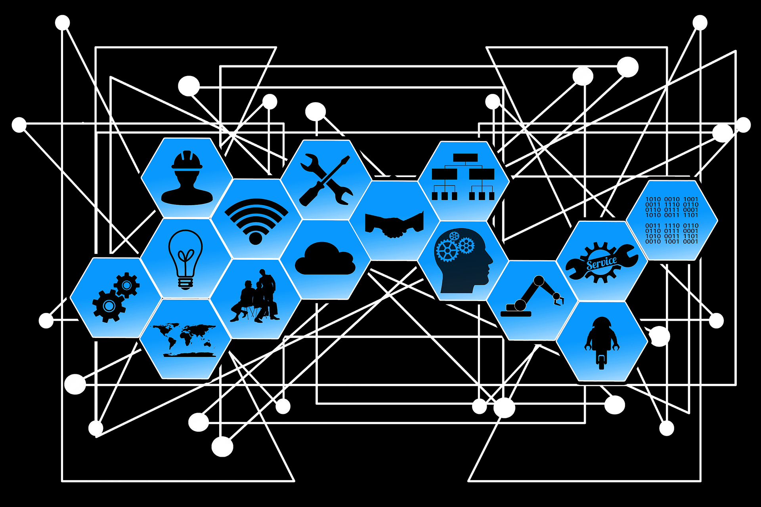
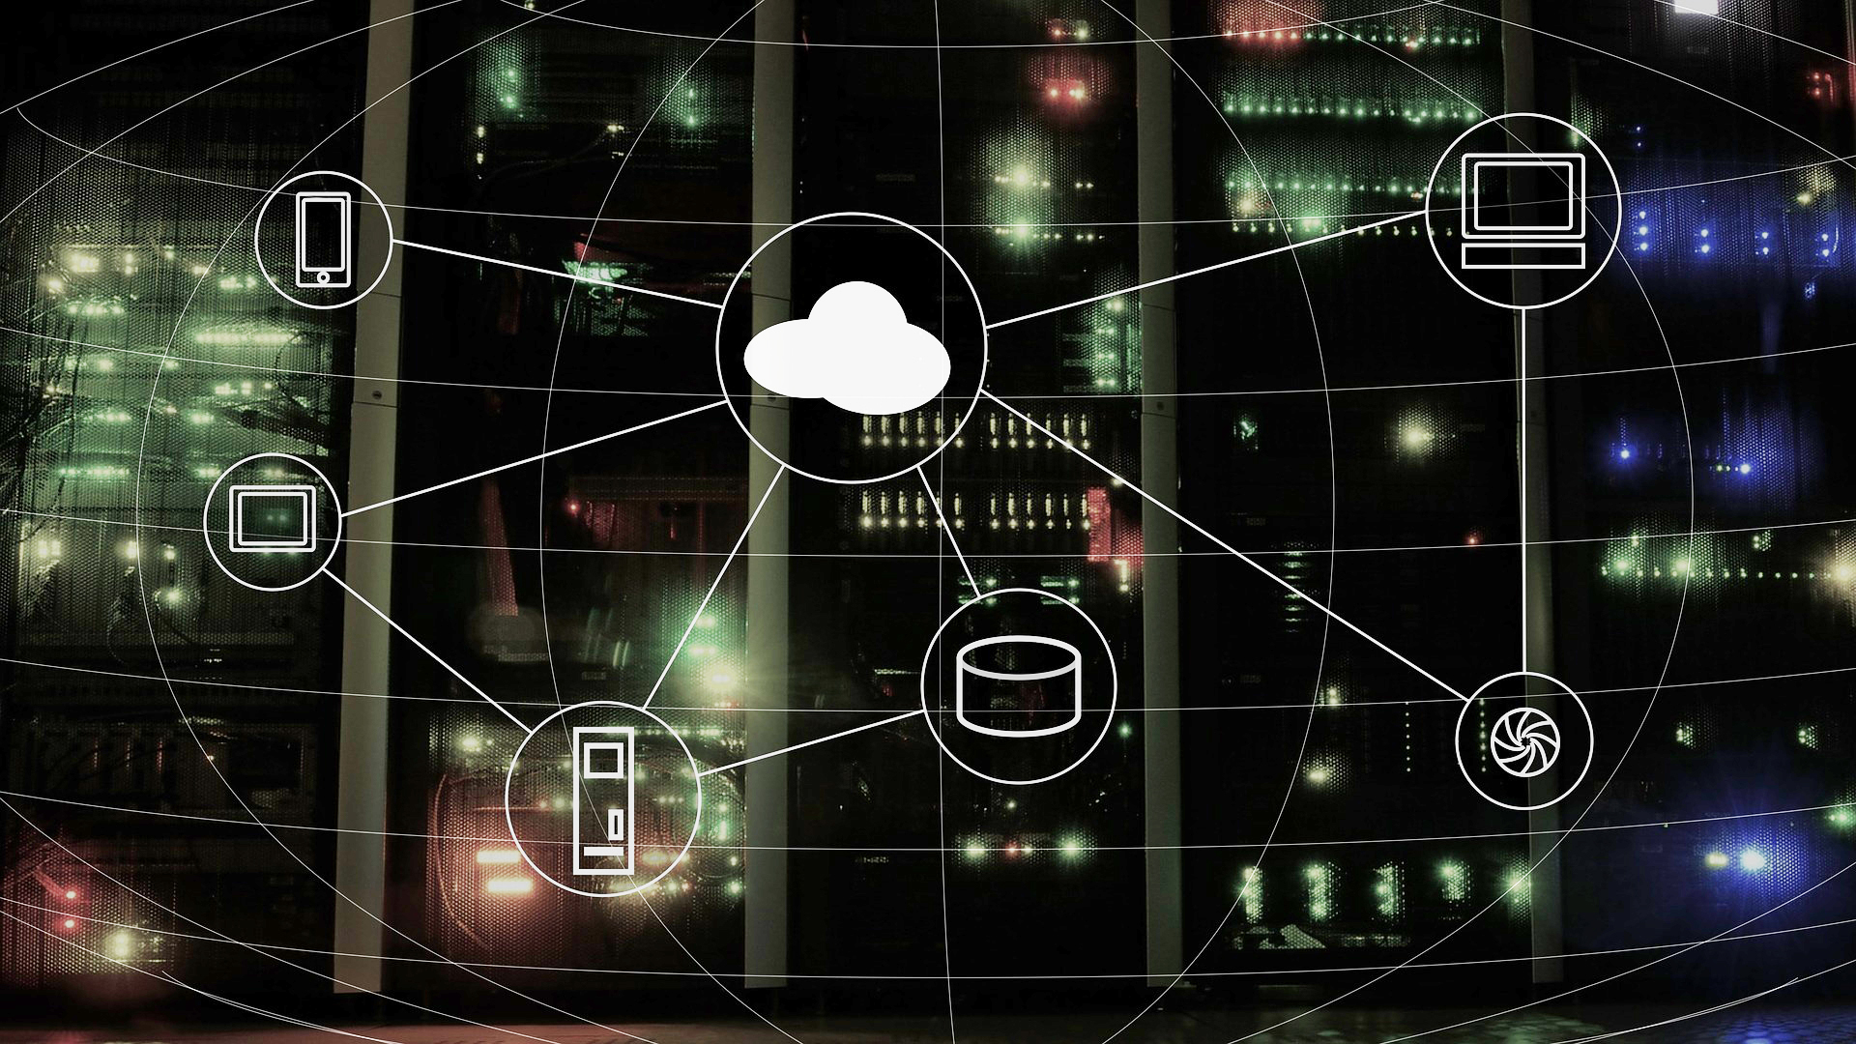
cyber-physical systems (CPS)
CPS are objects which have embedded software and electronics connected to each other in a system, for example, robots, drones and other movable machines. This way physical and mechanical objects and processes are connected with software-controlled objects and processes – with the real and virtual worlds converging. CPS can be used for traffic control or for managing intelligent electricity networks.
Image from Pixabay https://pixabay.com/illustrations/industry-4-0-web-network-points-2741774/
Cloud computing
Cloud computing covers all activities taking place on an online service (For example: sending e-mails, processing documents via an online platform and saving them there, playing videos or analysing data). It makes an IT infrastructure which makes it possible for data to be saved on decentralised computer systems via the internet and to be available at any time at any place as long as there is an internet connection. Thus, a cloud provider offers a complete working place in a virtual form (such as computer, memory, platforms and software applications) creating great flexibility for the user.
Image from Pixabay https://pixabay.com/illustrations/cloud-computing-network-internet-2001090/

Slide 7
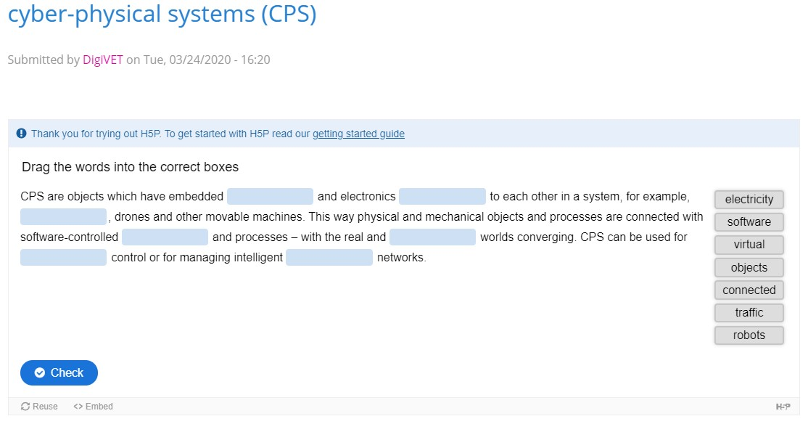
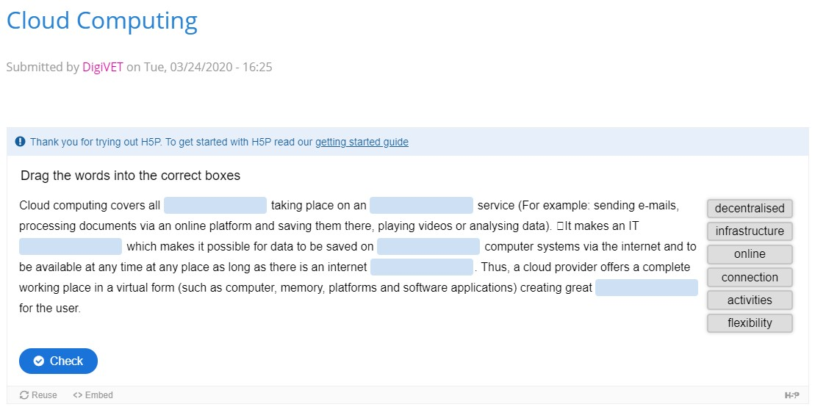
TASK
Exercise can be found in the link https://h5p.org/node/760844
Exercise can be found in the link https://h5p.org/node/760853

Slide 8
the internet of things (IoT)
The IoT is a network of connected devices that can communicate with each other and provide data to users through the Internet. IoT devices can connect to the Internet and often have sensors that enable them to collect data. An IoT device can be useful on its own, but when you use numerous devices together, they become even more valuable. IoT technology enables the user to collect data automatically from many different functions. IoT technology can also be used to automate equipment and parts of industrial operations.
Image from Pixabay https://pixabay.com/photos/turn-on-turn-off-industry-energy-2923046/
Industrial internet of things (IIOT)
IIoT is a subcategory of IoT. The term refers to IoT technology used in Industrial settings, namely in manufacturing facilities. IIoT is a key technology in Industry 4.0, the next phase of the industrial revolution. Industry 4.0 emphasises smart technology, data, automation, interconnectivity, artificial intelligence and other technologies and capabilities.
These technologies are revolutionising the way factories and industrial organizations are run.

Slide 9
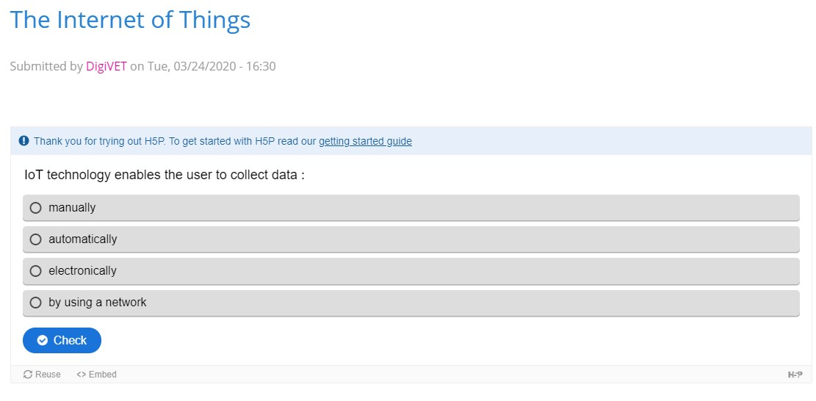
TASK
Exercise can be found in the link https://h5p.org/node/760859

Slide 10
History of Industry 4.0
Industry 1.0
Mechanical production equipment powered by steam
Industry 2.0
Mass production
Industry 4.0
Intelligent production
Industry 3.0
Autmated production
Source: followed - Image from Techutzpah https://techutzpah.com/evolution-of-industrial-revolution-4-0/

Slide 11
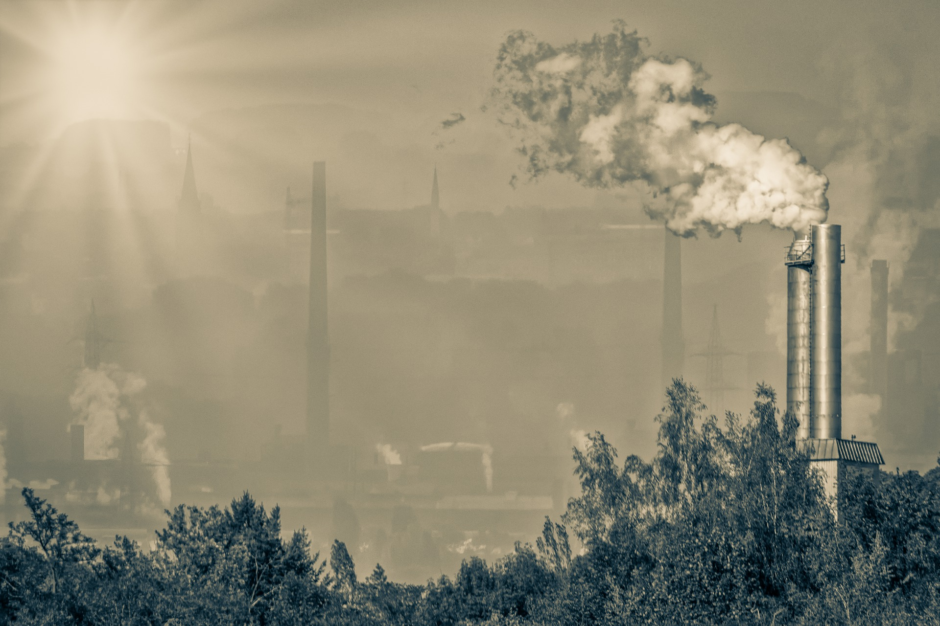
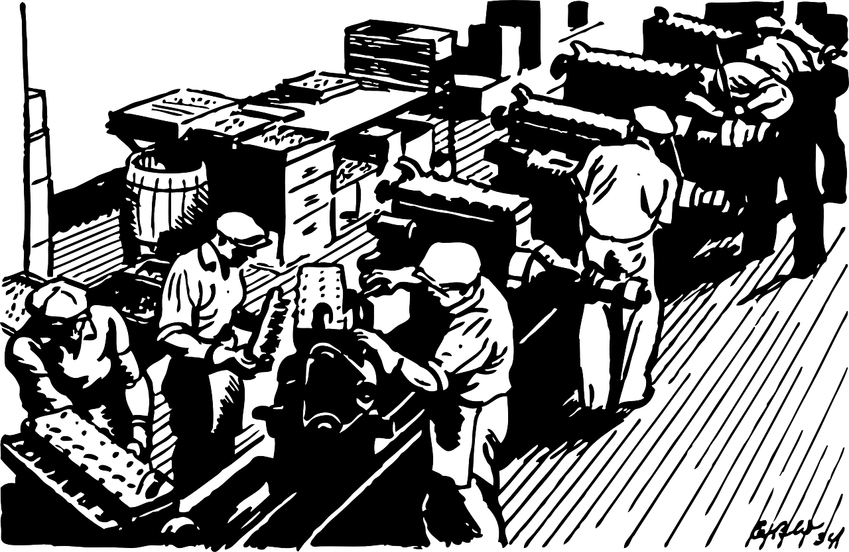
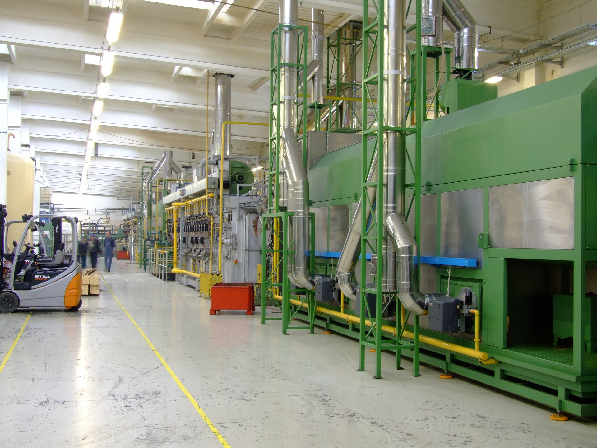
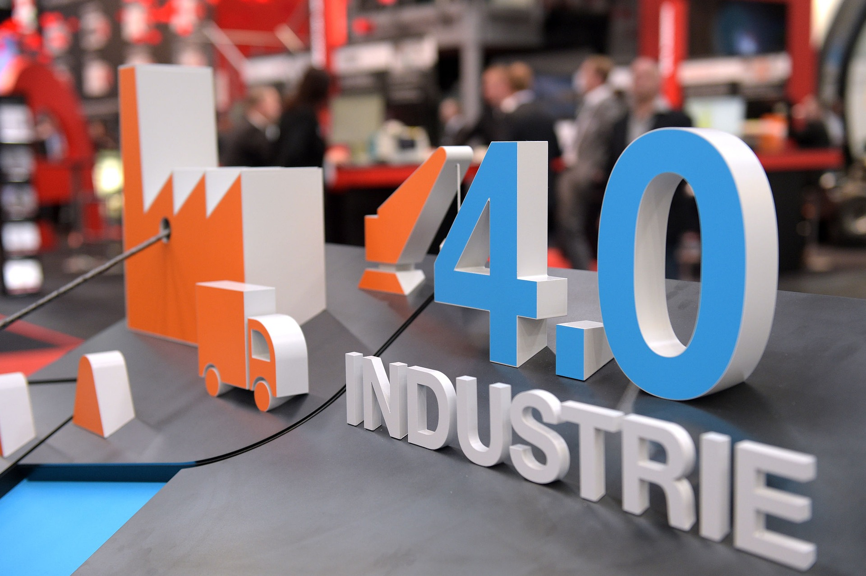
History of Industry 4.0
The First industrial revolution began with the mechanization and mechanical power generation in 1800s. It brought the transition from manual work to the first manufacturing processes (mainly in the textile industry). An improved quality of life was a main driver of the change.
Image from Pixabay https://www.pexels.com/photo/high-angle-view-of-a-man-256381/
The Second industrial revolution was triggered by electrification that enabled industrialization and mass production. It was a period when advances in steel production, electricity and petroleum caused a series of innovations that changed society. With the production of cost effective steel, railroads were expanded and more industrial machines were built.
Image from Pixabay https://pixabay.com/vectors/factory-car-engine-assembling-35104/
The Third industrial revolution is characterized by the digitalisation with introduction of microelectronics and automation. In manufacturing this facilitates flexible production, where a variety of products is manufactured on flexible production lines with programmable machines. Such production systems however still do not have flexibility concerning production quantity.
Image from Pixabay https://pixabay.com/photos/company-factory-production-186980/
Today we are in the Fourth industrial revolution that was triggered by the development of Information and Communications Technologies (ICT). Its technological basis is smart automation of cyber-physical systems with decentralized control and advanced connectivity (IoT functionalities). The consequence of this new technology for industrial production systems is reorganization of the automation systems to a self-organising cyber physical production system, that allows flexible mass custom production and flexibility in production quantity.
Image from Pixabay
https://pixabay.com/photos/industrial-4-0-information-2470457/
Exercise: https://h5p.org/node/705116

Slide 12
TASK
Exercise can be found in the link https://h5p.org/node/705116

Slide 13
industry 4.0 - The Fourth Industrial Revolution
Check out this video, produced by the Siemens company regarding Industry 4.0 and the vision of tomorrow's manufacturing… What are your thoughts on this?
TASK
https://www.youtube.com/watch?v=HPRURtORnis

Slide 14
CONTACT
Universität Paderborn
Department Wirtschaftspädagogik Lehrstuhl Wirtschaftspädagogik II Warburger Str. 100
33098 Paderborn
http://www.upb.de/wipaed
http://digivet.eduproject.eu/
Prof. Dr. Marc Beutner
Tel: +49 (0) 52 51 / 60 - 23 67
Fax: +49 (0) 52 51 / 60 - 35 63
E-Mail: marc.beutner@uni-paderborn.de
The European Commission support for the production of this publication does not constitute an
endorsement of the contents which reflects the views only of the authors, and the Commission cannot be held responsible for any use which may be made of the information contained therein.
14

Slide 15
Thank you for your attention!

